Slide 1
Ecosystem Conditions

Slide 2
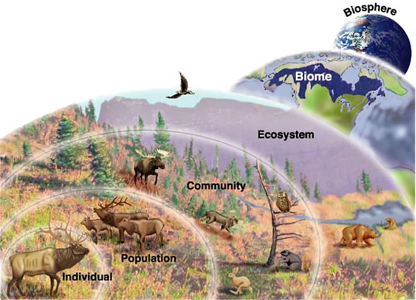

Slide 3
Organization in Ecology
Biome: regional or global community of organisms characterized by climate conditions
Ecosystem: All of the living and non-living things within a given area
Community: Groups of different species living and interacting within a given area
Population: Group of the same species living within a given area
Organism: An individual living thing
Relationships exist at each level that affect every other level.

Slide 4
Factors in an Ecosystem
Biotic Factors: All plants, animals, fungi, and bacteria that play a role in the ecosystem. Biotic factors would include food webs and parts of biogeochemical cycles.
Abiotic Factors: Non-living things such as moisture, temperature, wind, and soil that affect the ecosystem. The exact balance of abiotic factors often determines what can or cannot live within an ecosystem.
The balance between biotic and abiotic factors determines the carrying capacity of each population in the ecosystem.

Slide 5
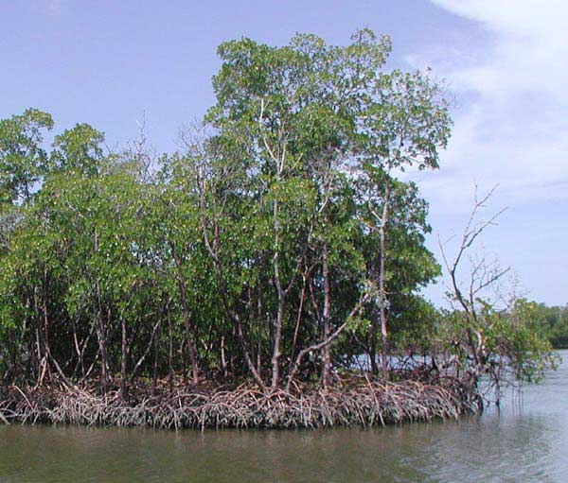

Slide 6
Relationship Examples
In the previous picture you saw mangrove trees in a salt-water marsh.
The mangrove trees grow based on the level of oxygen in the mud and the salinity of the surrounding water.
The mangrove trees serve as shelter and food for young fish.
After the fish have matured, they swim to nearby coral reefs and increase the stability of the reefs.
Reefs that are farther out at sea do not have as much stability because they lack this relationship.

Slide 7
Changing Factors
Slight changes over time can affect the ecosystem.
For example: increased rainfall may greatly benefit one species of plant at the expense of another.
In this case, the population that has benefitted will increase and the population that is upset will decrease.
Over time a more average rainfall may cause the populations to cycle back to their original state.
Even if the numbers of populations change, the whole community remains generally unchanged.
Either way, most ecosystems obtain an approximate equilibrium.

Slide 8
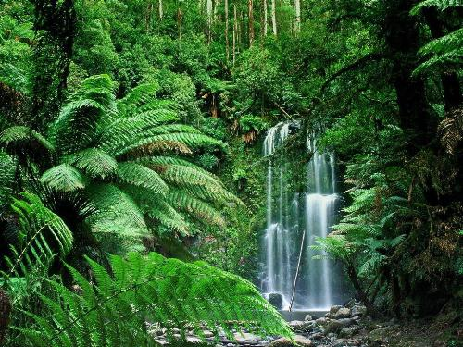

Slide 9
Biodiversity
Biodiversity: The overall variety of living things in an ecosystem.
Small changes may affect communities but not ecosystems as a whole. Larger changes that affect the biodiversity change the ecosystem.
Tropical rainforests cover 7% of Earth’s land but account for at least 50% of the known species.
With a large number of populations and generally limited resources, changes to the tropical rainforest can have a dramatic impact on the communities.
The large amount of biodiversity contributes to areas such as rainforests being deemed “hot spots” because they are threatened by human activity.

Slide 10
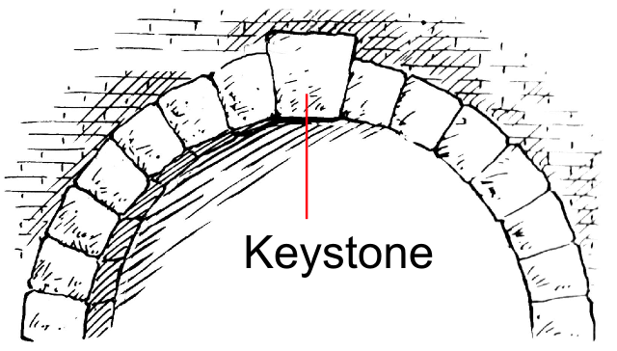

Slide 11
Keystone Species
Certain species are connected to everything else in the ecosystem.
When beavers build a dam, they radically change the ecosystem
If the beavers and their dam are removed, the level of standing water drops, which affects the populations of fish, and therefore the populations of birds and other animals that feed on the fish.
If a keystone species is lost the entire ecosystem becomes damaged, or possibly completely destroyed.
In other words, if the keystone is removed, the arch collapses.

