Slide 1
Linnaean Classification

Slide 2
Previously…
Ecological Organization
Biosphere (containing everything)
Biome
Ecosystem
Community
Population
Organism – the individuals

Slide 3
Switching Gears
We’ve looked at how things interact and talked about how those interactions affect the various levels of ecological organization.
For the next unit, we’ll be looking at how organisms are related. Specifically, we’ll be looking at how organisms are classified based on ancestry.

Slide 4
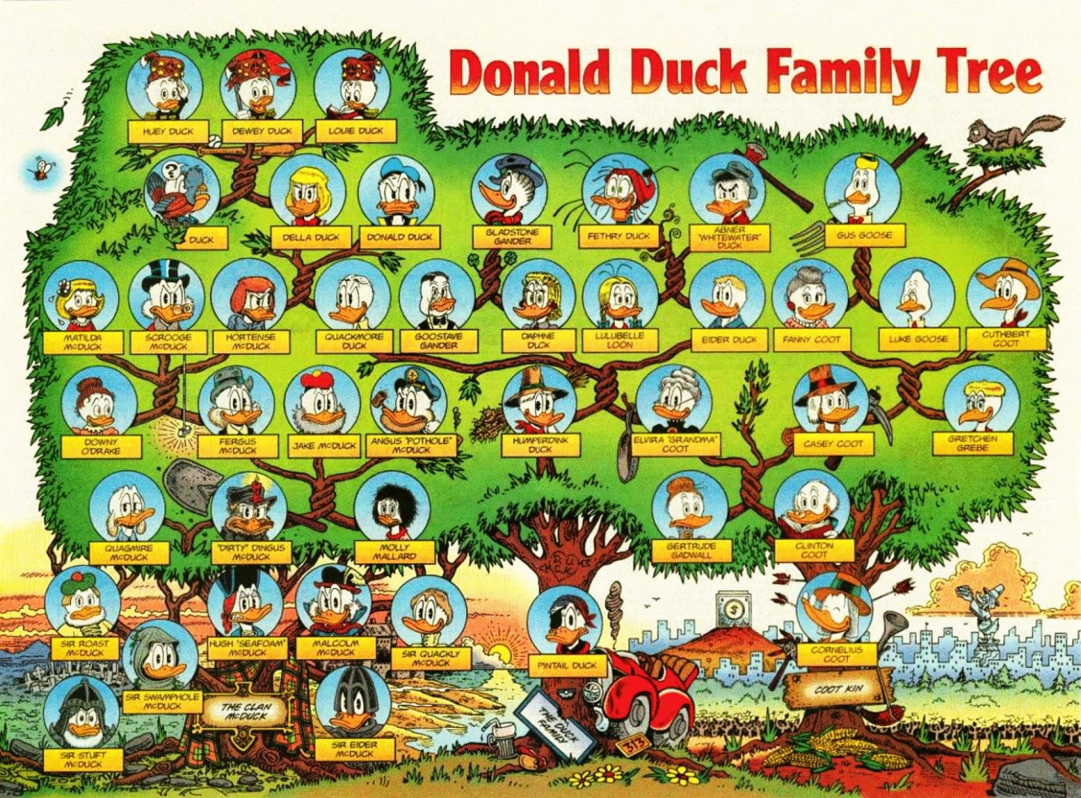
Family Tree Example

Slide 5
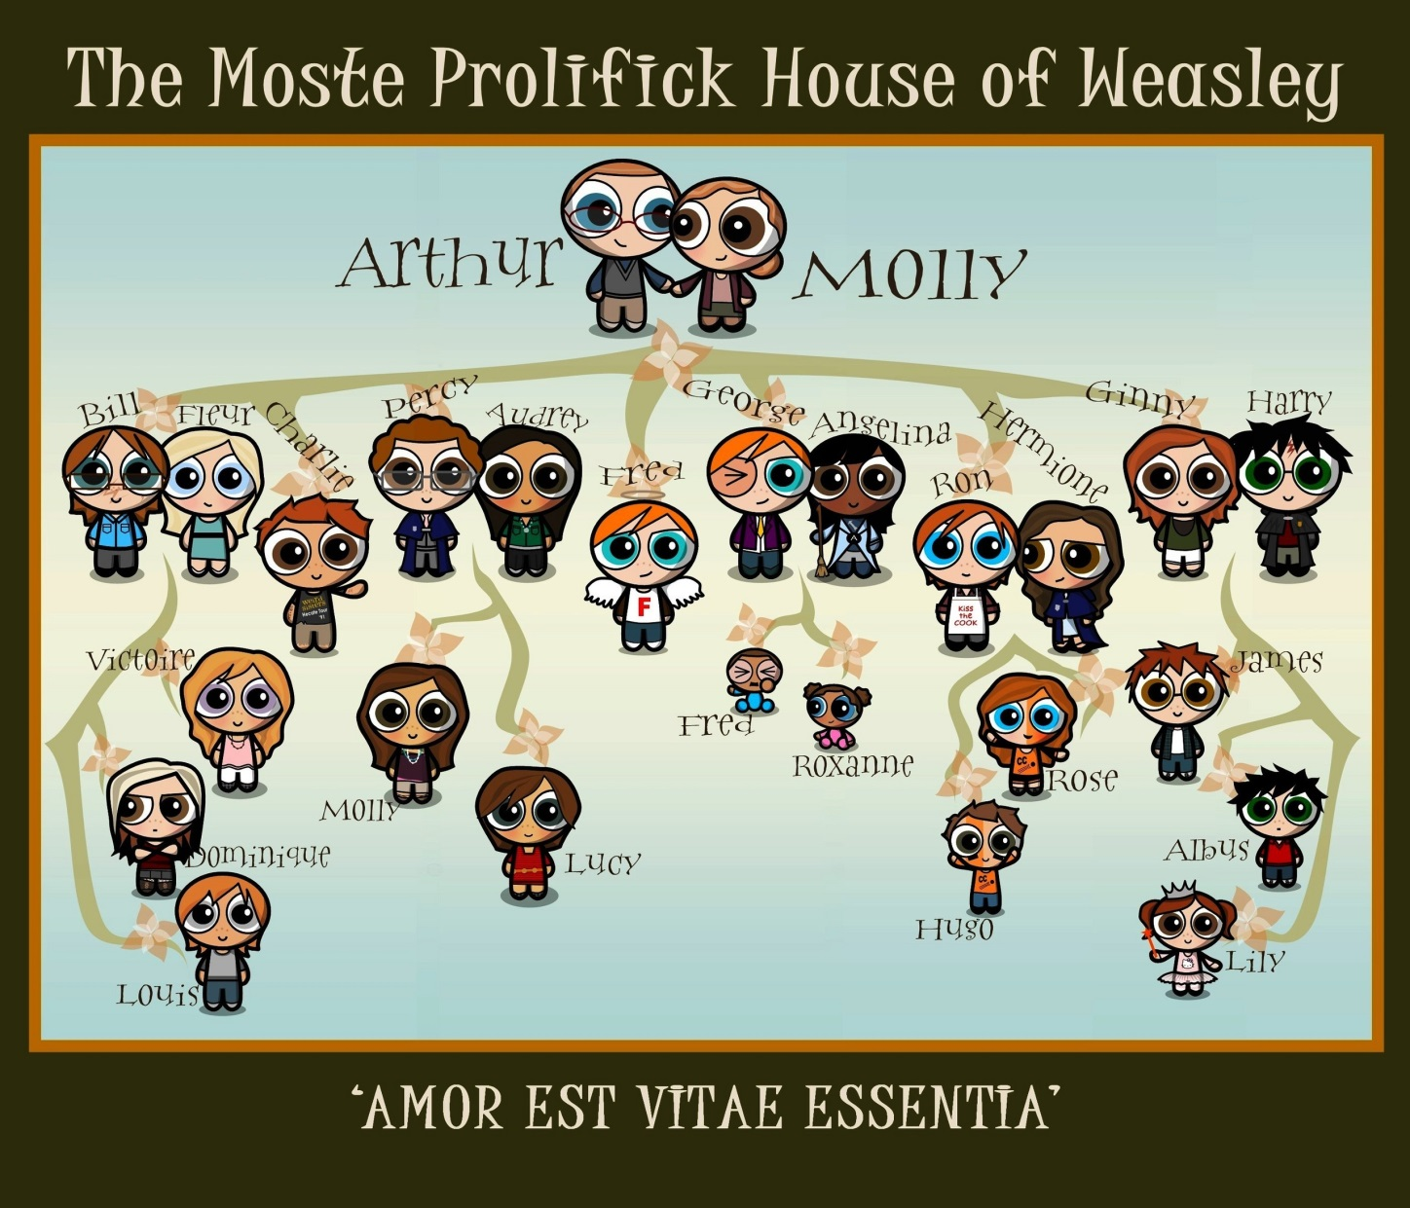
Family Tree Example

Slide 6
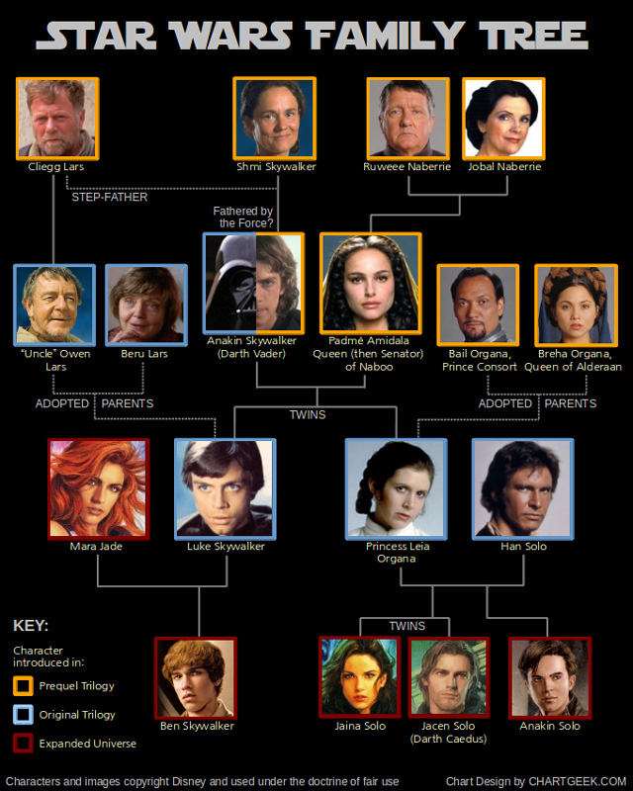
Family Tree Example

Slide 7
Ancestry
Eventually, we will look at ancestry from a genetic standpoint, as with a family tree.
For now, ancestry refers to a common ancestor, which is an the most primitive version of all related organisms.

Slide 8
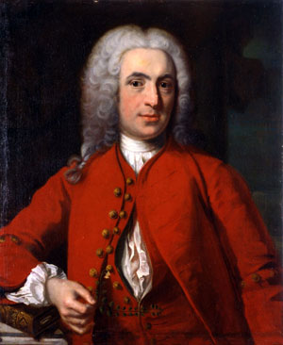
Carl Linnaeus (1707-1778)
Swedish botanist, zoologist, and professor.
Changed his name to Carolus because
He was obsessed with Latin
He was obsessed with classifying things.
His obsessions led to the standard classification system we use today.

Slide 9
Some Vocabulary
Taxonomy: the science of naming and classifying organisms.
Typically uses physical or structural traits
Creates a hierarchy of organisms
A group within the system is called a taxon. We will often refer to different taxa as we talk about groups.
Species will refer to a group of organisms that can breed and reproduce, and whose offspring are viable and also able to reproduce.

Slide 10
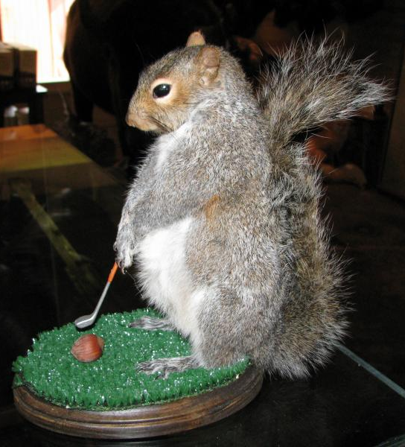
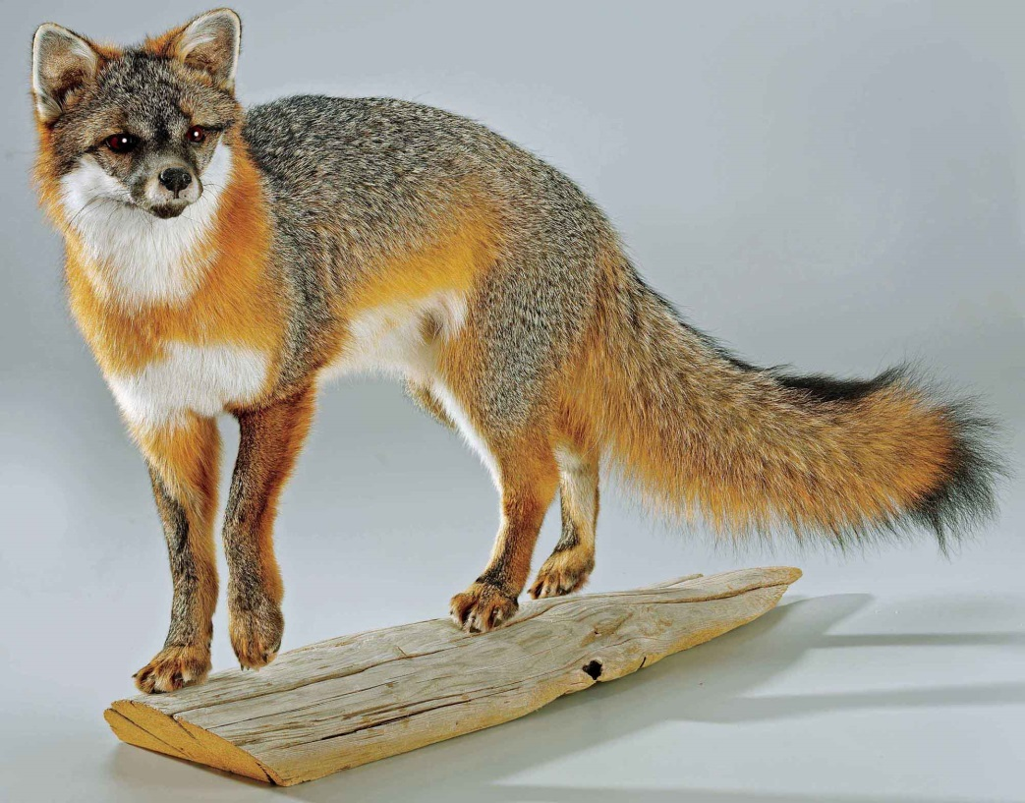
Taxidermy

Slide 11
Linnaeus’ System
Focuses on binomial nomenclature, which Linnaeus developed using…
LATIN!
All individuals belong to a genus and a species.
Genus names are always italicized when typed or underlined when written. They are also always capitalized.
Species names are always italicized when typed or underlined when written. These are always lower case.
The species name is the specific descriptor that sets individuals apart, such as a trait, a native habitat, or the name of the person who discovered it.

Slide 12
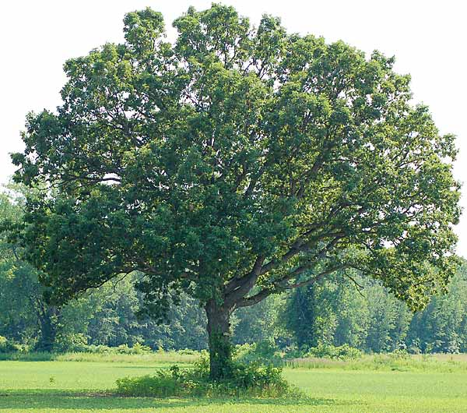
White Oak Tree
Quercus alba

Slide 13
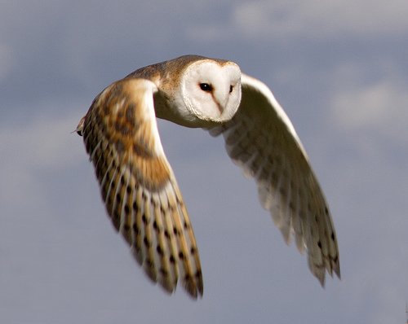
Barn Owl
Tyto alba

Slide 14
Why binomial nomenclature?
The same species could have many common names, either within regions of a country or across the globe.
Specific names and descriptors allow global communication without confusion.
Some genera (plural form of genus) may contain hundreds of species.

Slide 15
Linnaeus’ System
Kingdom (least specific)
Phylum
Class
Order
Family
Genus
Species (most specific)

Slide 16
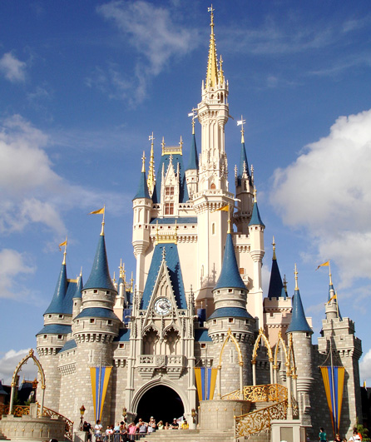
Kingdom

Slide 17
Defining Linnaean Taxonomy
Kingdom: most broad grouping of organisms (kinda)
Six kingdoms – Animalia, Plantae, Fungi, Protista, Archaea, Bacteria
Phylum: taxa that sort kingdoms into the most basic characteristics.
There are 35 phyla within kingdom Animalia
Class: more specific traits (111 classes within Animalia)
Order: more specific, often using similar suffixes for closely related orders within a class.
Example: primates

Slide 18
Defining Linnaean Taxonomy
Family: becoming very specific, only having a few organisms within. Family members often share many traits and can be confused with each other.
Example: cebidae
Genus: very closely related organisms that share most traits and very often share a common ancestor. Members within a genus often fill the same niche.
Example: Cebus
Species: the most specific taxa. A species will have one or more defining traits that no other members of the genus have.
Example: capucinus

Slide 19
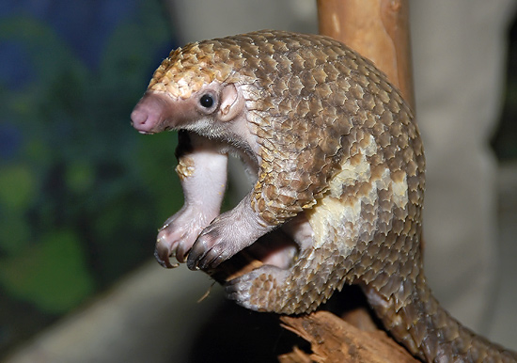
Pangolin

Slide 20
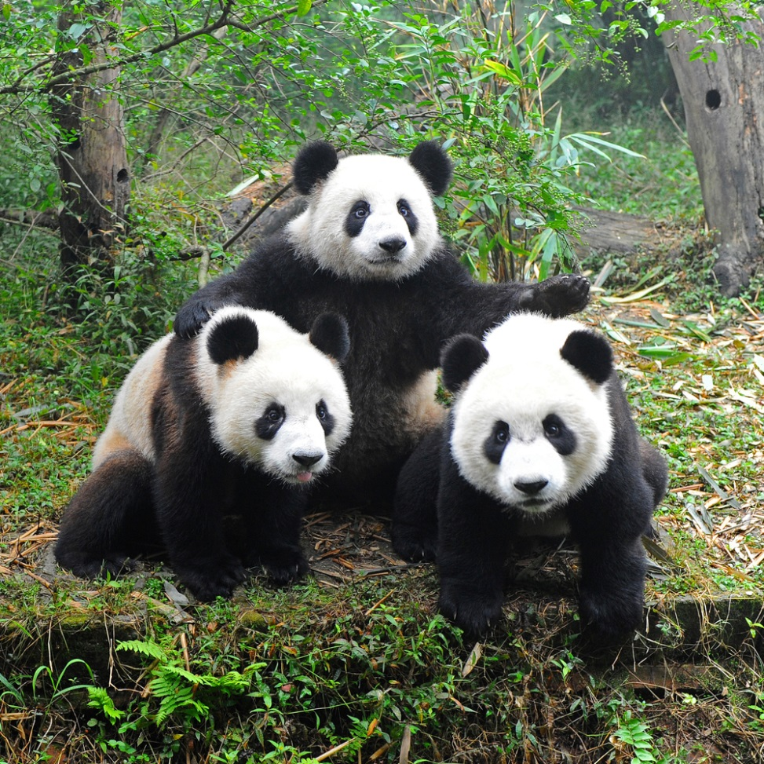
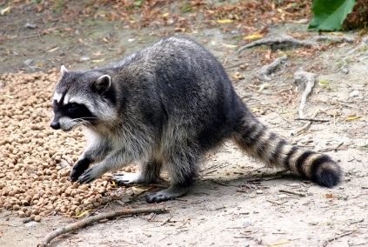
Giant Panda
Raccoon

Slide 21
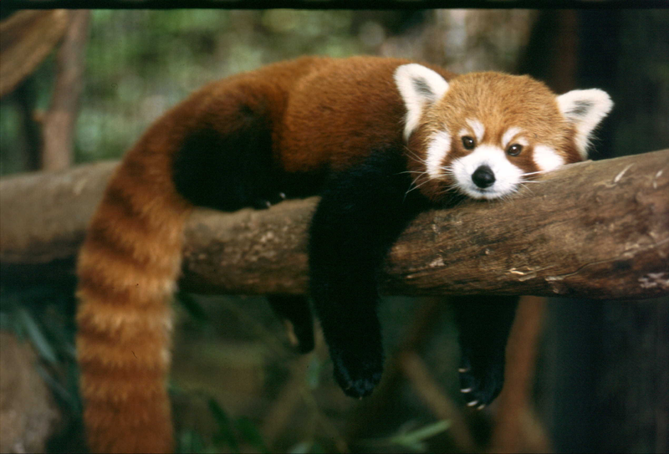
Red Panda

Slide 22
Limitations
Linnaean taxonomy focuses specifically on physical traits and similarities.
In the Linnaean system, completely unrelated species may develop similar traits and therefore be classified together.
Modern technology allows us to look at the genetic information and therefore truly look at a species’ common ancestor.

